Slide 1
Angular Final Project Arun Krishna N an72@dedalus.eu

Slide 2
Features implemented
Following features have been implemented in this app development. JSON-Server-Auth nginx pipes Form handling Lazy loading of modules Routing, Child routing and params HTTPClient and Observables Angular Material Controls Service calls with secure end points (Token based auth)

Slide 3
Still in pending stage Need to Modify Admin dashboard
User : 1. Once logged in using user type you will be routed to Hospital homepage.
2.On clicking Book now you will be redirected to appointment form submission.
3.On clicking Learn more you will route to Learnmore component.
4.On clicking logout you will be returned to Login page.
5.On submitting, data will be updated to the JSON Server
6.Registering the user will be added to JSON file.
Admin:
1.You will access the “Pending status ” appointments as shown below
2.On clicking the approve It will be updated in the JSON.

Slide 4
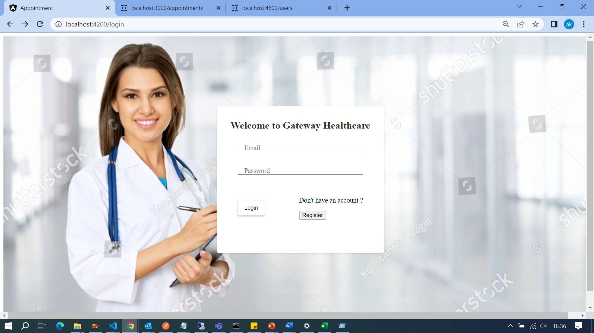
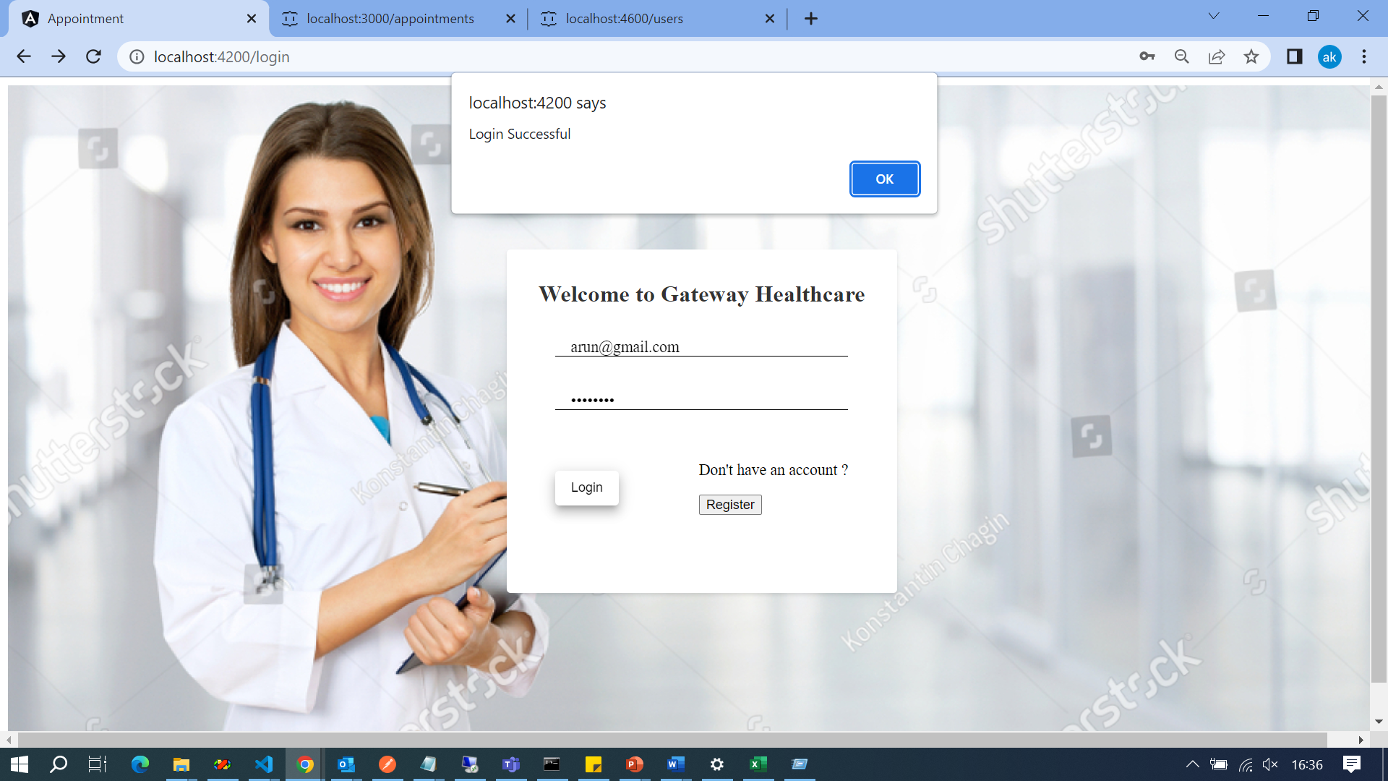
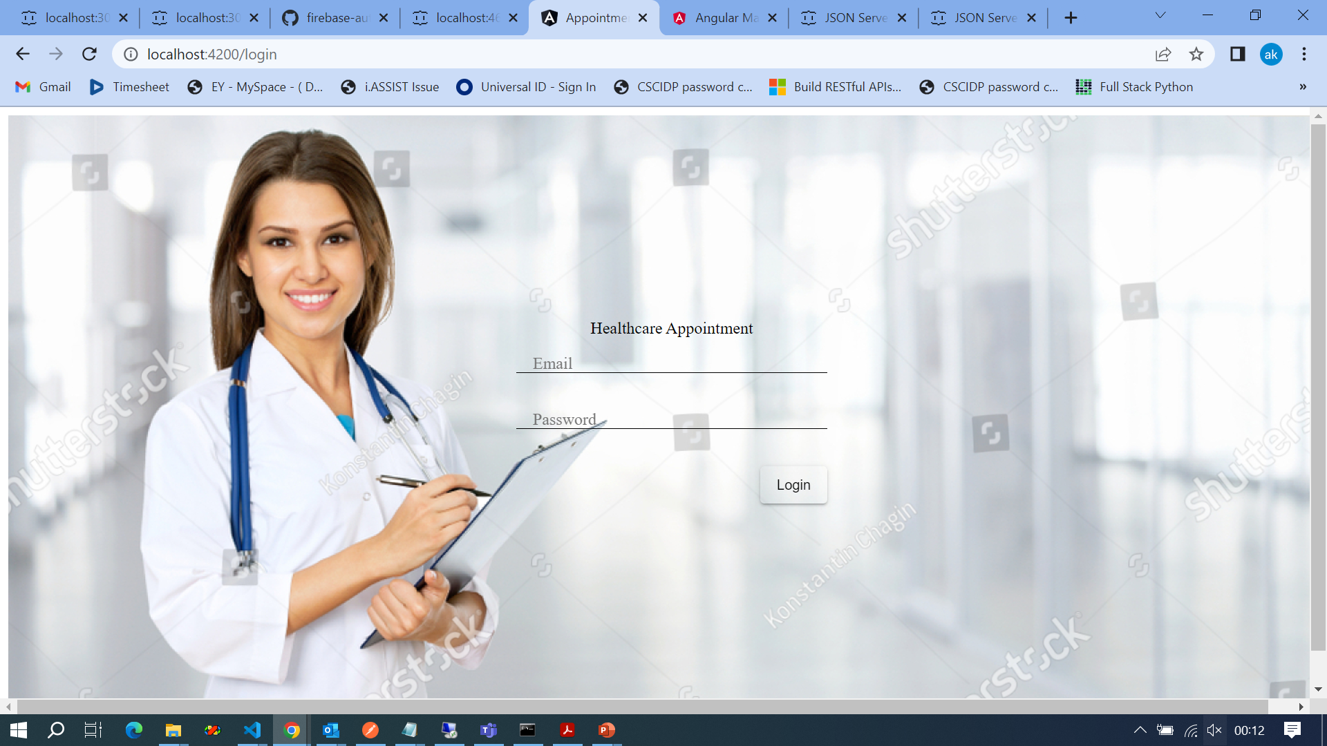
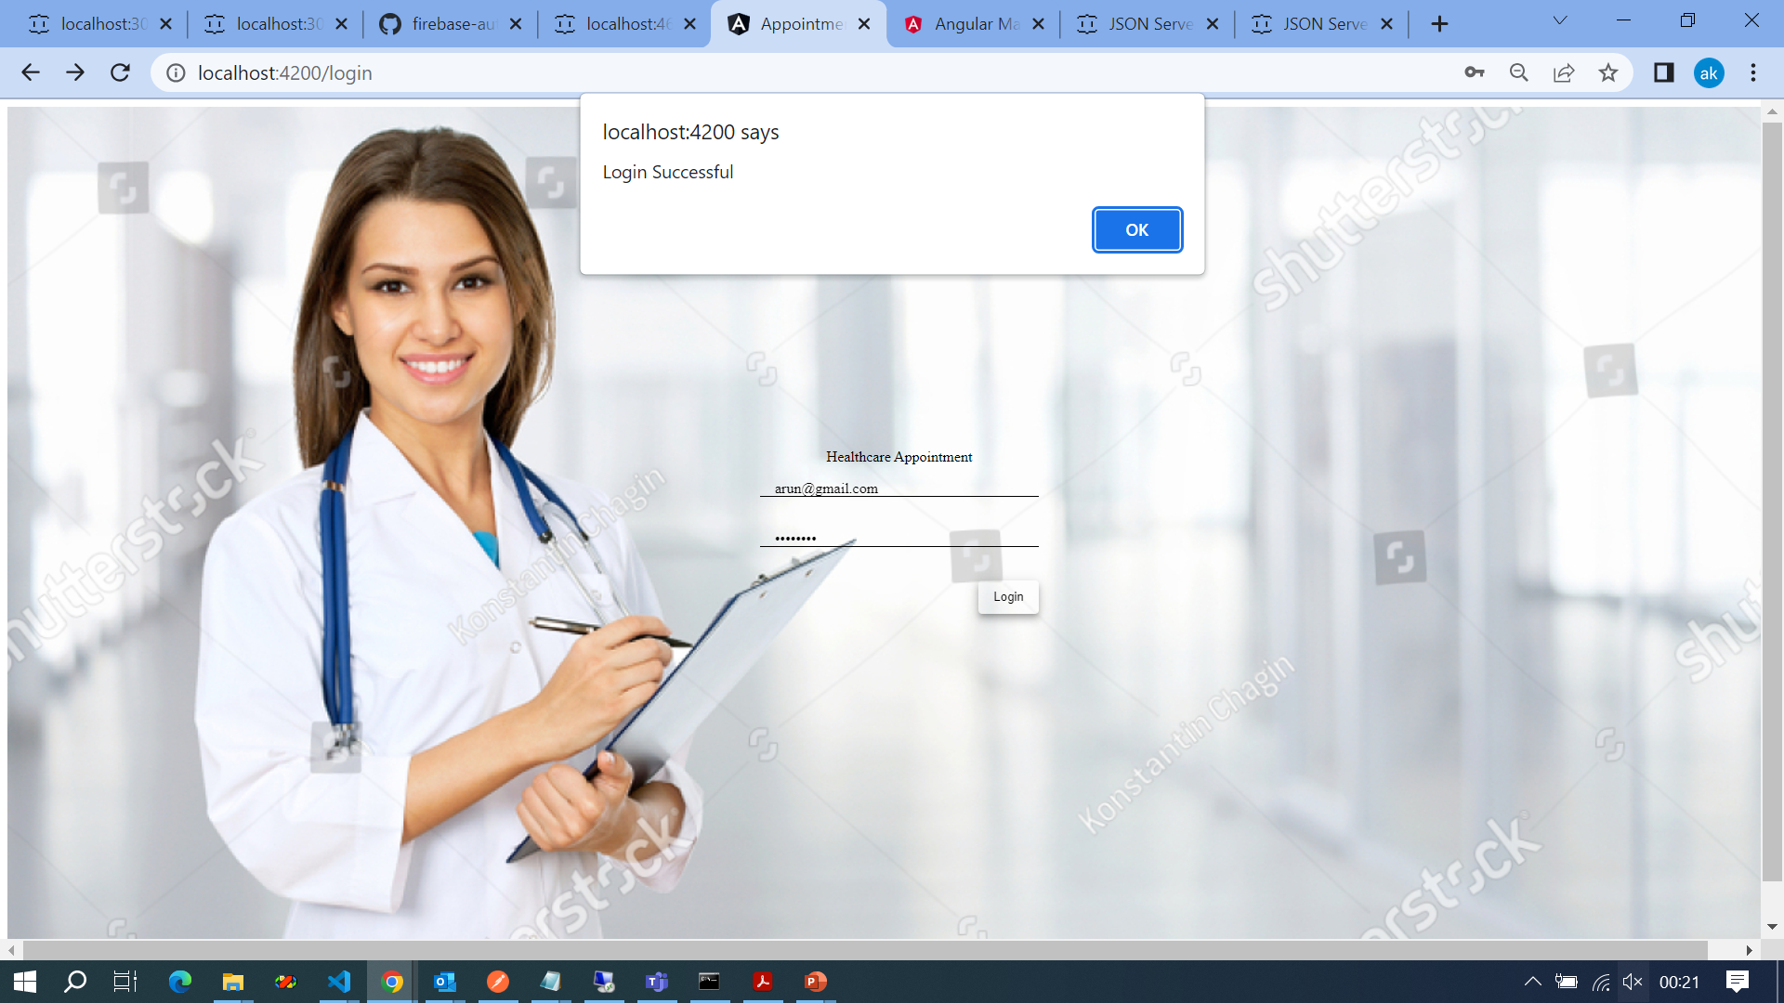

Slide 5
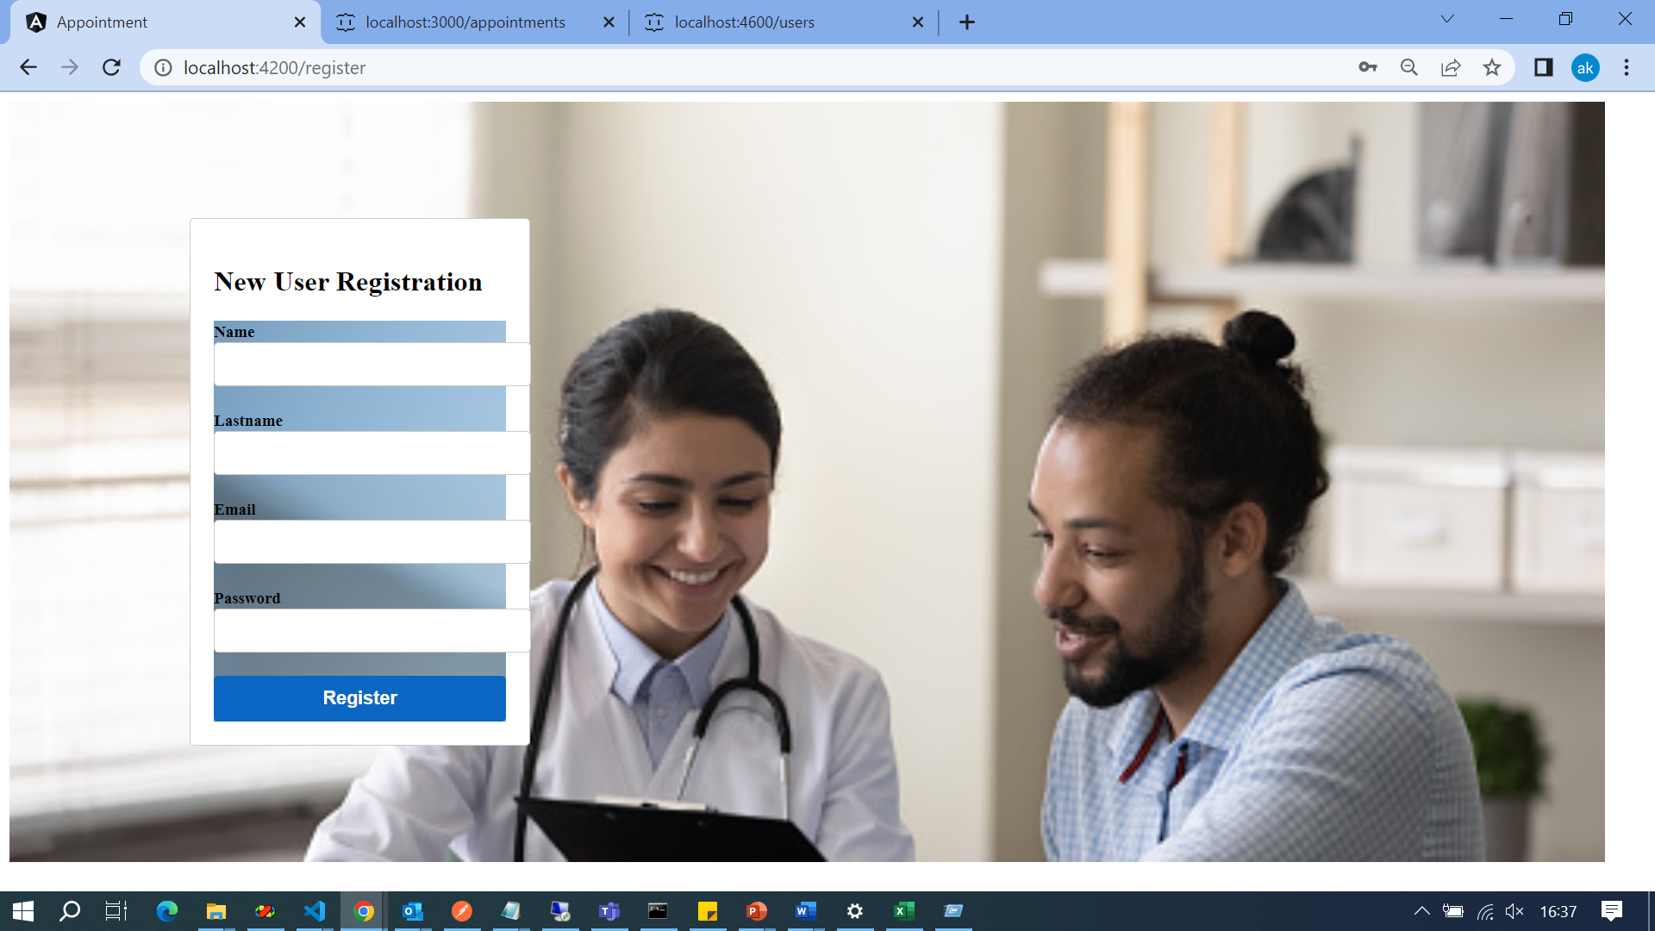

Slide 6
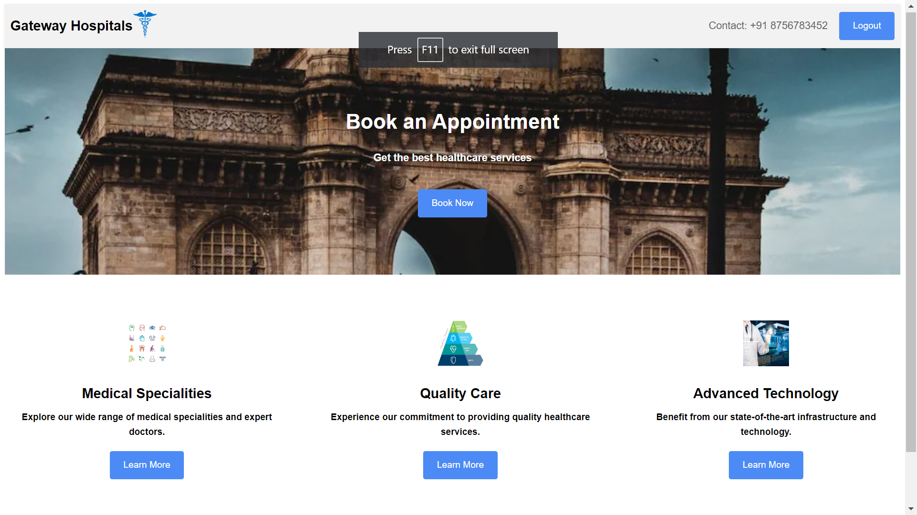
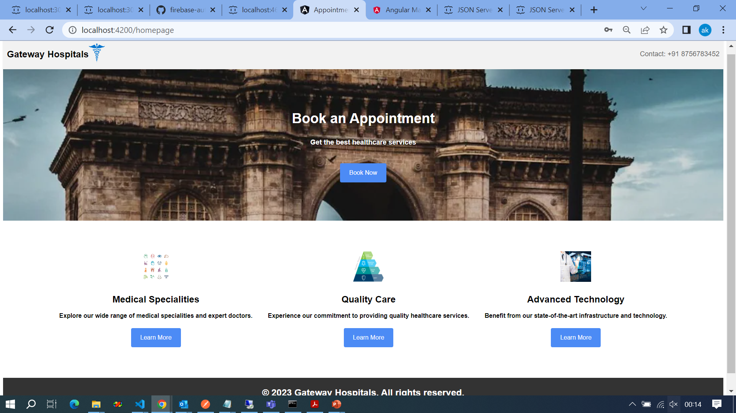

Slide 7
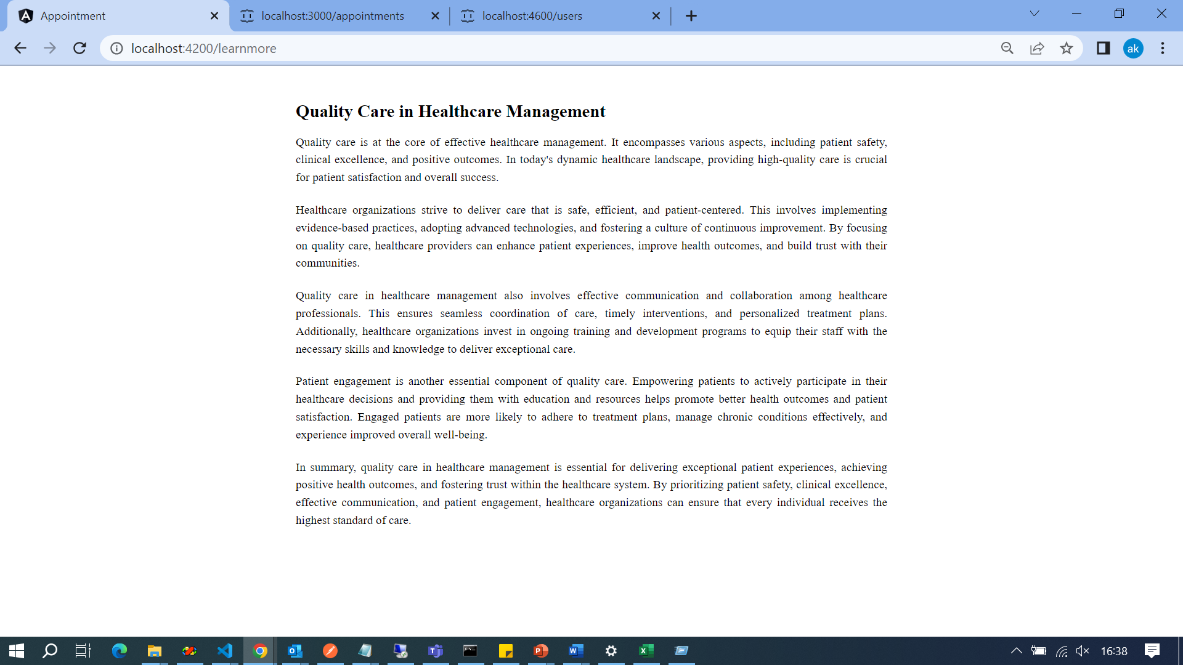

Slide 8
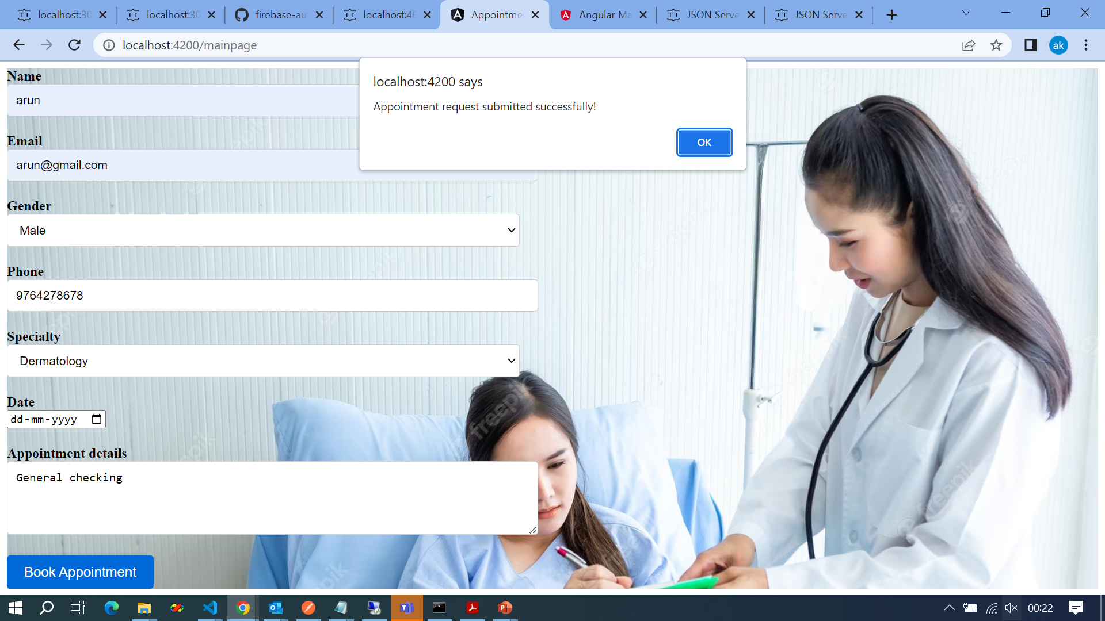

Slide 9
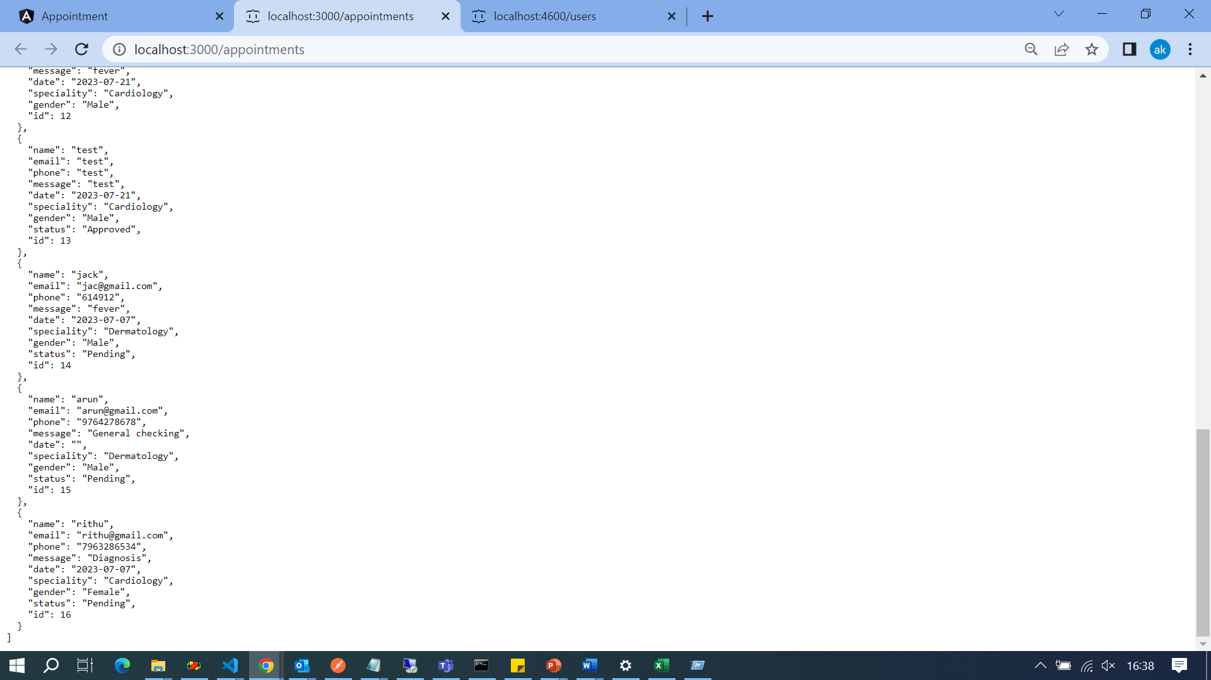
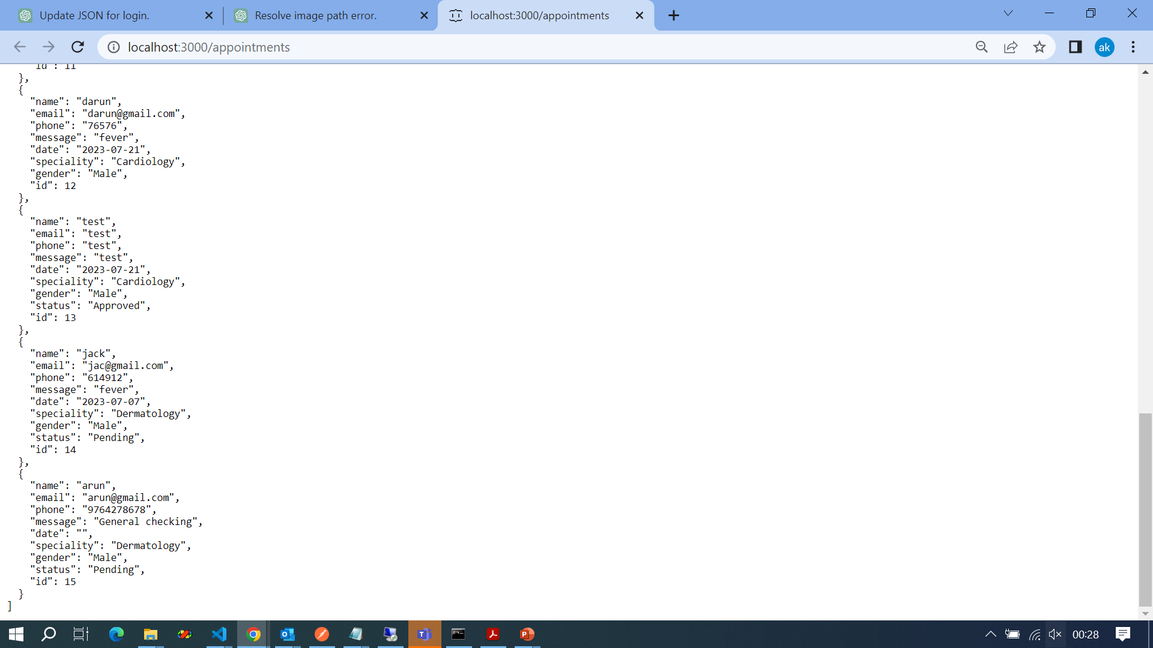

Slide 10
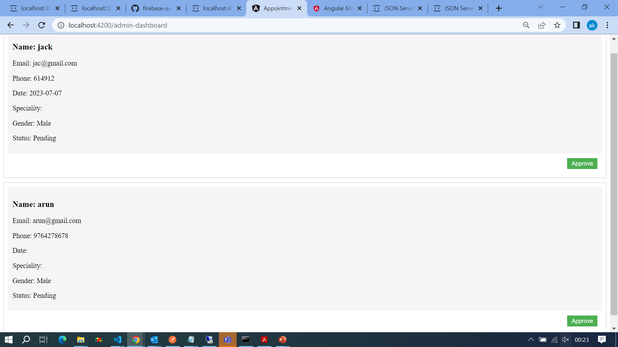

Slide 11
END
Thank YOU

